Slide 1
Capstone 3: Supervised Leaning
Predicting 30-day Readmission
for Heart Failure Patients
Presented by Kathie King

Slide 2
Introduction: context of the project
In October 2012, the Centers for Medicare & Medicaid Services began reducing Medicare (CMS) payments for Inpatient Prospective Payment System hospitals with excess readmissions.
The Hospital Readmission Reduction Program (HRRP) encourages hospitals to improve communication and care coordination efforts to better engage patients and caregivers, with respect to post-discharge planning.

Slide 3
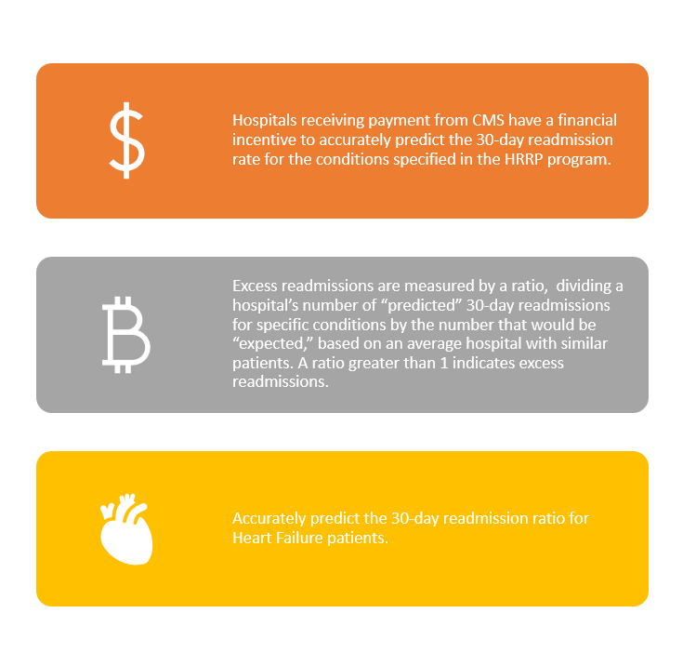
Specified research question to be addressed by predictive modeling

Slide 4
Preparing the data: 5 original datasets:
unplan_readm_df: 54093 entries reduced to 4930, measure column name = READM_30_HF, value = 1, 'Compared to National' with 5 possible values - dummy, missing 172 'Provider ID', *1238 missing values - fill with mean by hospital & READM_30_HF*;
readm_red_df: 19674 entries reduced to **2670**, no ZIP code column, measure column name = READM_30_HF_HRRP, value = 1, **created additional feature 'actual_rratio' = target value for model**, *602 missing values for 'Number of Discharges' and 'Number of Readmissions' - dropped as it will be impossible to calculate the 'actual_rratio', which is the target value*;
mort_meas_df: 91889 entries reduced to 4930, measure column name = MORT_30_HF, value = 1, 'Compared to National' with 5 possible values - dummy, *missing 172 'Provider ID', missing 1331 each of Denominator, Score, Lower Estimate, and Higher Estimate - fill with mean by hospital if available*;
hcahps_df: 455235 entries reduced to 3552, bfill missing from star & linear mean columns, *missing 116 Provider ID values*;
gen_info_df: 5334 entries, all categorical, converted to dummies, no null.

Slide 5
Creating Target Value
Excess
Excess Readmission Ratio: represents Hospital's "predicted" number of readmissions compared to CMS "expected" number of readmissions.
Calculate
Calculate the **Actual Readmission Rate** = 'actual_rrate' (number of readmissions/discharges)
Calculate
Calculate the **Actual Readmission Ratio** = 'actual_rratio' ('actual_rrate'/'Expected Readmission Rate') in order to compare the Excess Readmission Ratio
Target
target = 'actual_rratio'

Slide 6
Missing values: before merge
unplan_readm_df: 1238 missing values - fill with mean by hospital & READM_30_HF;
readm_red_df: 609 missing values for 'Number of Discharges' and 'Number of Readmissions' - dropped as it will be impossible to calculate the 'actual_rratio', which is the target value;
mort_meas_df: missing 172 'Provider ID', missing 1331 each of Denominator, Score, Lower Estimate, and Higher Estimate - fill with mean by hospital if available;
hcahps_df: missing 116 Provider ID values;
gen_info_df: no missing.
zip_fip_df: 53971 total entries; 338 missing '2013 code' values

Slide 7
Adding Additional Data: geographical classification by ZIP code
1 Large central metro —Counties in MSAs of 1 million or more population that: 1.Contain the entire population of the largest principal city of the MSA, or 2. Have the entire population contained in the largest principal city of the MSA, or 3. Contain at least 250,000 inhabitants of any principal city of the MSA.
2 Large fringe metro —Counties in MSAs of 1million or more population that did not qualify as large central metro counties.
3 Medium metro —Counties in MSAs of populations of 250,000 to 999,999.
4 Small metro —Counties in MSAs of populations less than 250,000.
5 Micropolitan —Counties in MSAs of populations less than 250,000.
6 Noncore —Nonmetropolitan counties that did not qualify as micropolitan

Slide 8
Merging
5609 (entries from original 5 datasets)
+ 53971 (from zip_fip_df)
= 7146 entries
after filling missing values: total 5039 usable entries

Slide 9
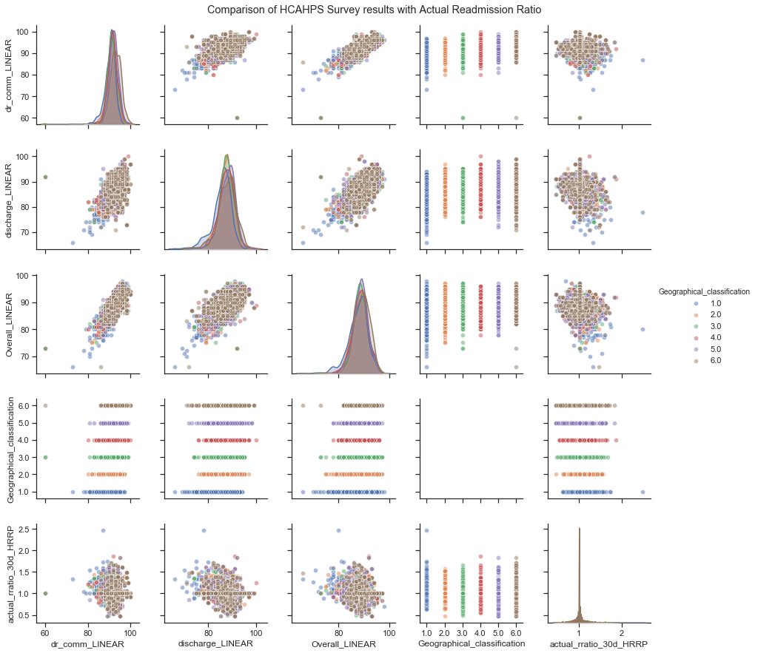
Data exploration: continuous features

Slide 10
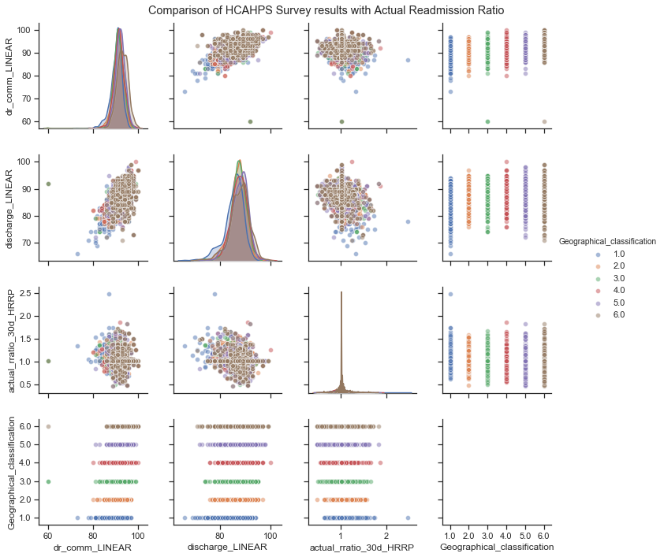
Data exploration: continuous features

Slide 11
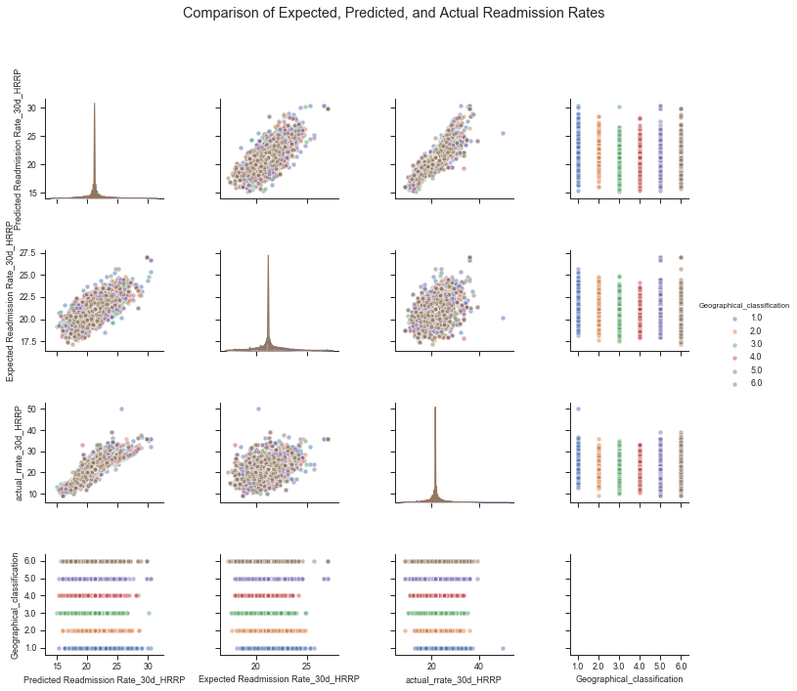
Data exploration: continuous features

Slide 12
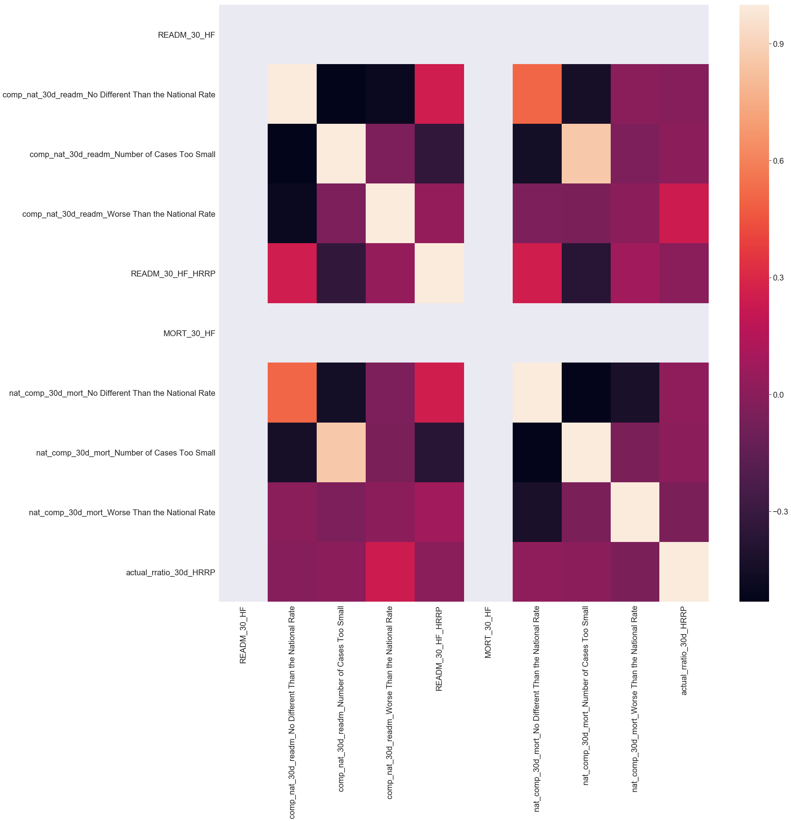
Data exploration: categorical features

Slide 13
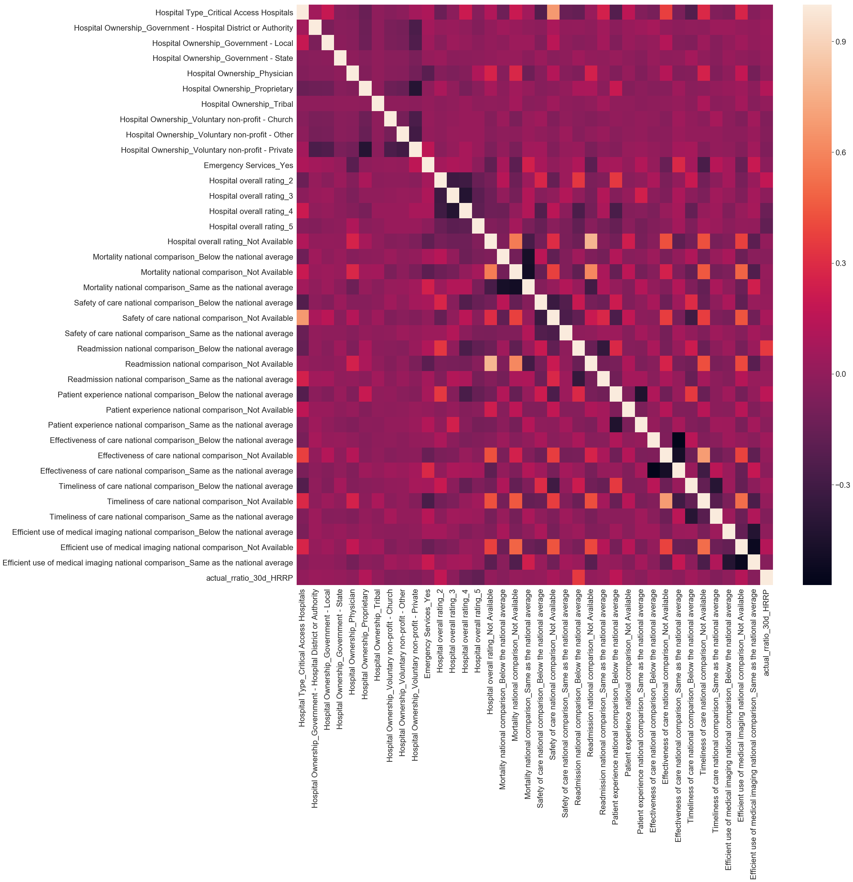
Data exploration: categorical features

Slide 14
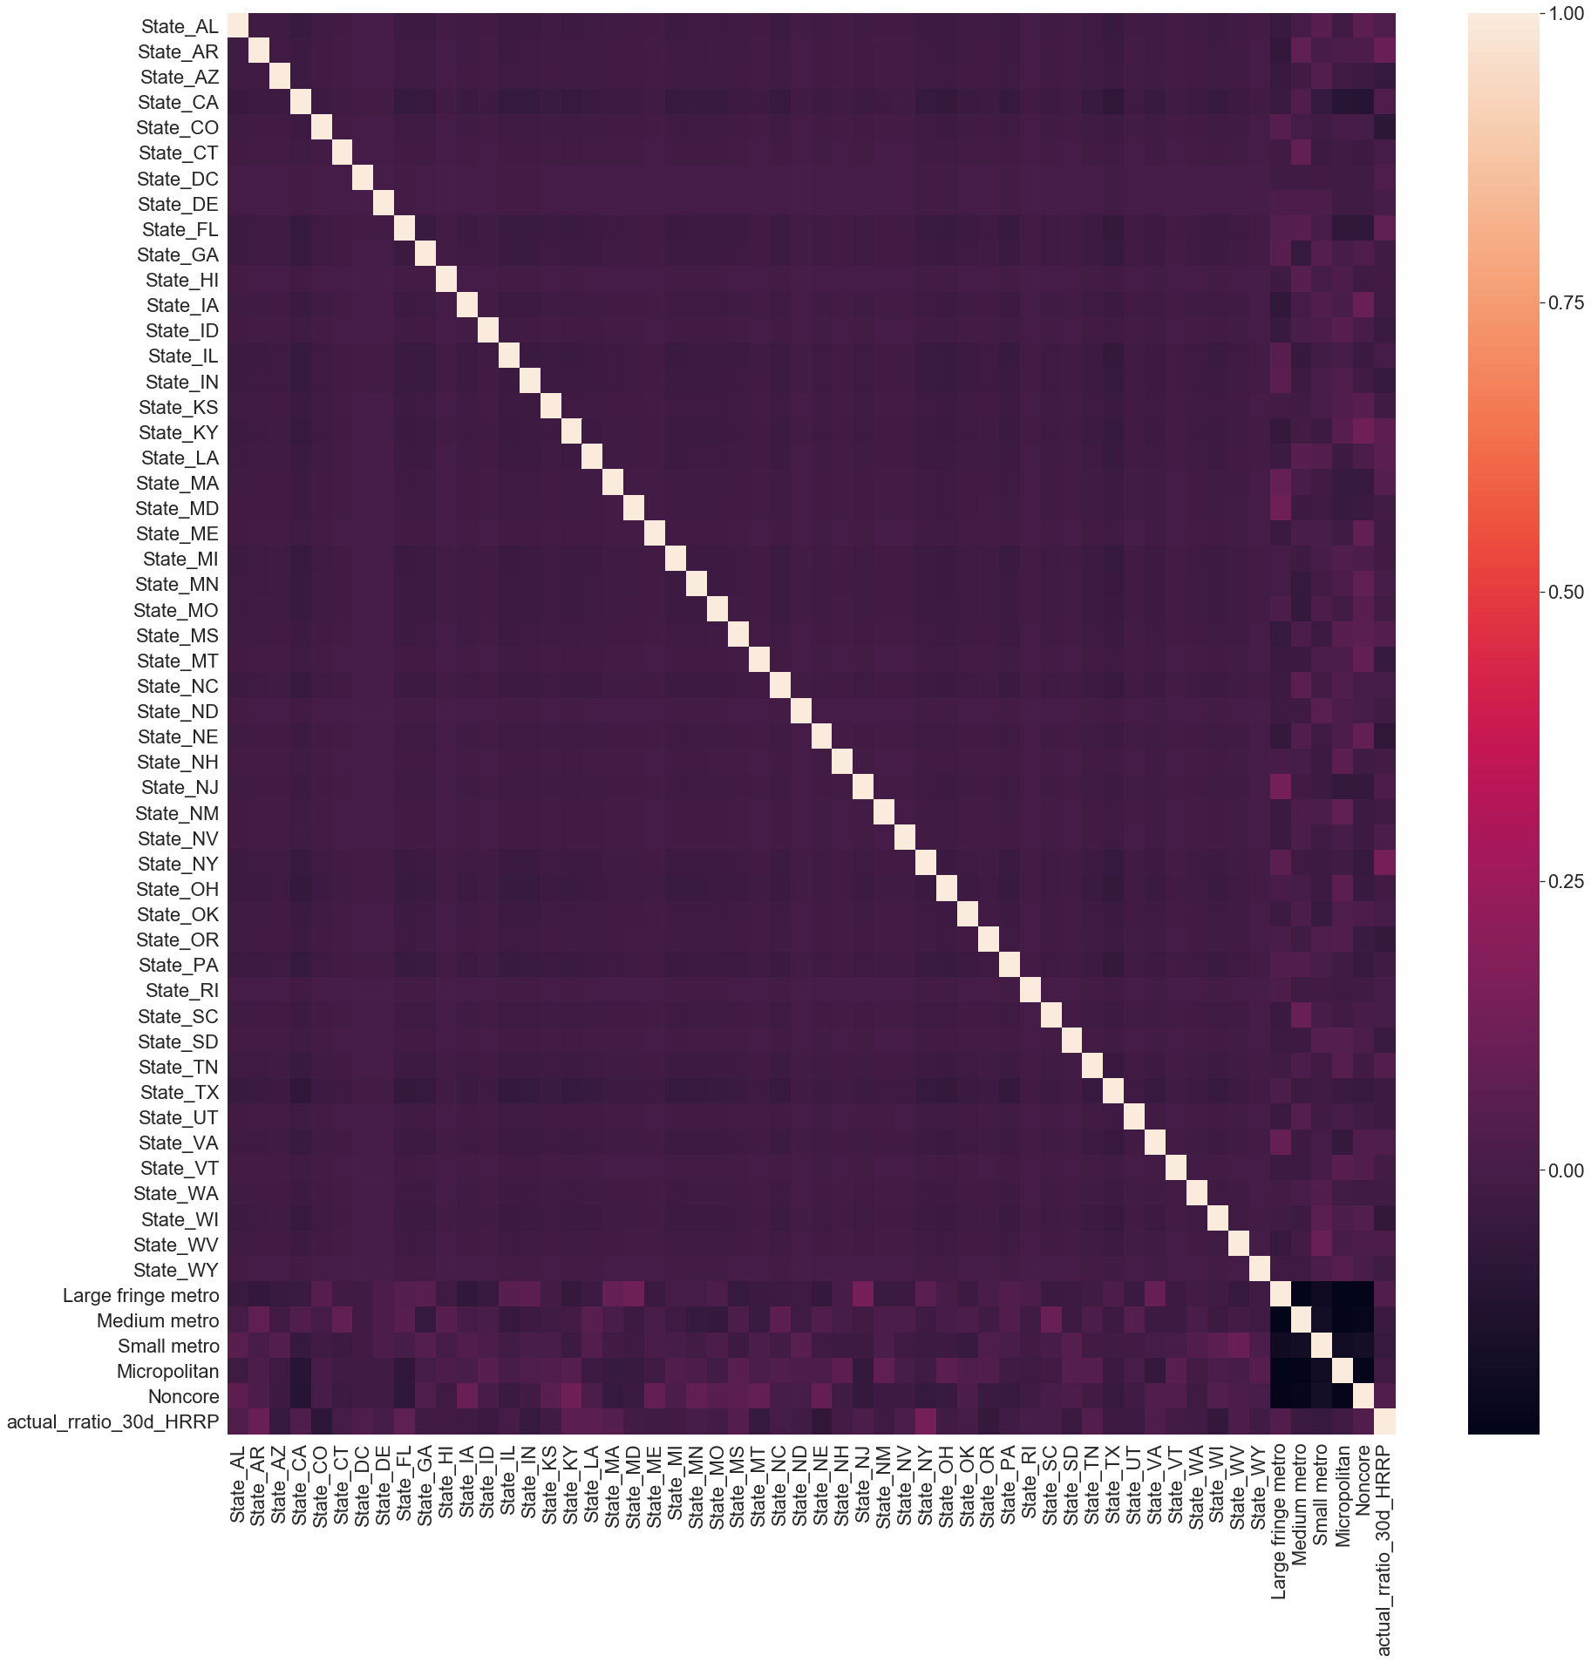
Data exploration: categorical features

Slide 15
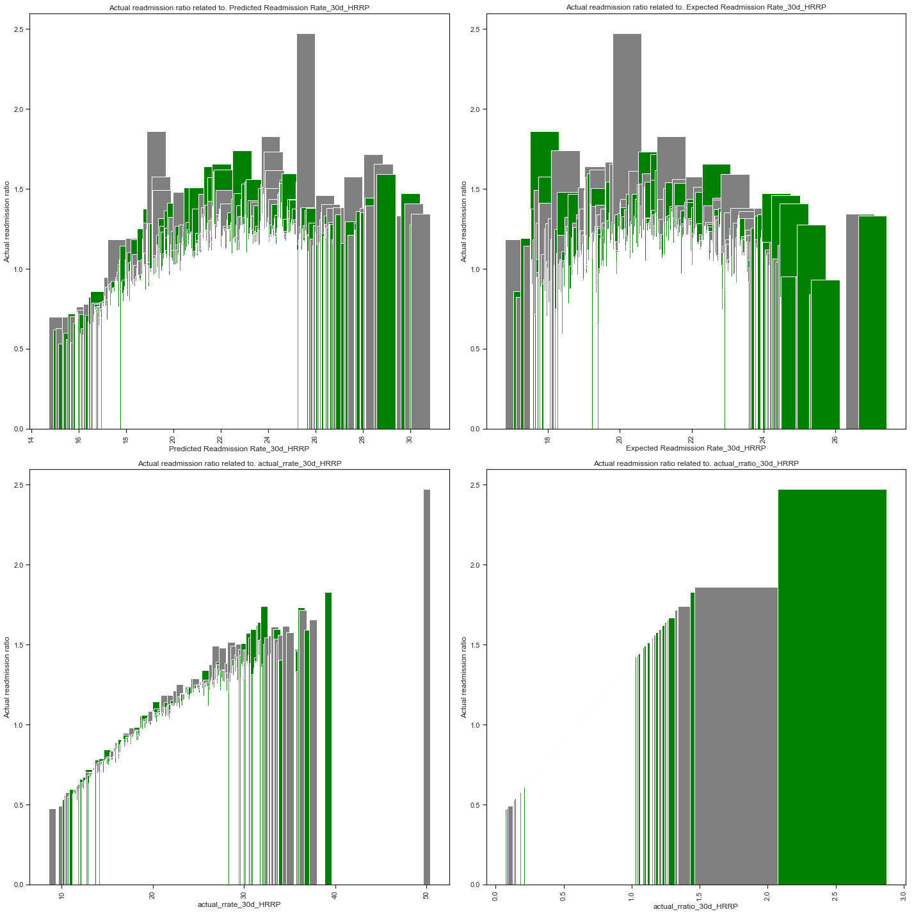
Data exploration: categorical & continuous features

Slide 16
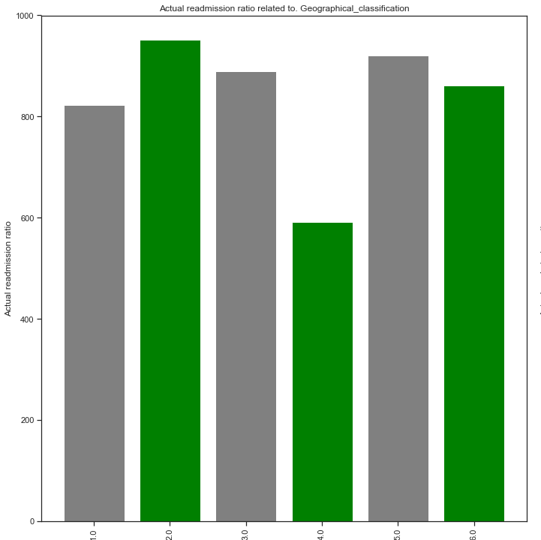
Data exploration: categorical & continuous features

Slide 17
Feature Selection: round 1
train set: R-squared: 0.999
Adj. R-squared: 0.999
F-statistic: 5.860e+04
Prob (F-statistic): 0.00
AIC: -3.324e+04
BIC: -3.253e+04
MAE: 0.0022479498101130786
MSE: 2.7881821830847437e-05
RMSE: 0.005280324027069498
MAPE: 0.22017933374532347

Slide 18
Feature Selection: round 2
train set: R-squared: 0.999
Adj. R-squared: 0.999
F-statistic: 8.111e+04
Prob (F-statistic): 0.00
AIC: -3.331e+04
BIC: -3.279e+04
MAE: 0.0022479498101130786
MSE: 2.7881821830847437e-05
RMSE: 0.005280324027069498
MAPE: 0.22017933374532347

Slide 19
Feature Selection: round 3
train set: R-squared: 0.999
Adj. R-squared: 0.999
F-statistic: 9.107e+04
Prob (F-statistic): 0.00
AIC: -3.331e+04
BIC: -3.285e+04
MAE: 0.0022258319245610867
MSE: 2.7869722252196517e-05
RMSE: 0.005279178179621949
MAPE: 0.21809480086822824

Slide 20
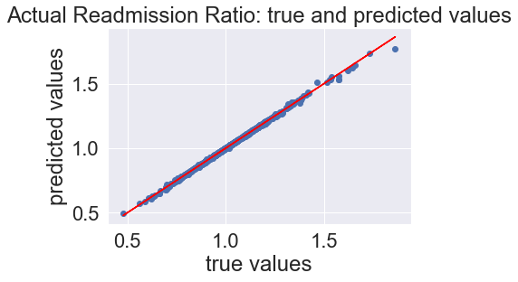
Model fitting

Slide 21
Feature Selection: round 4
train set: R-squared: 0.876
Adj. R-squared: 0.876
F-statistic: 2188
Prob (F-statistic): 0.00
AIC: -1.196e+04
BIC: -1.188e+04
MAE: 0.03490027037531688
MSE: 0.003923635149089057
RMSE: 0.06263892678749419
MAPE: 3.478248033010383

Slide 22
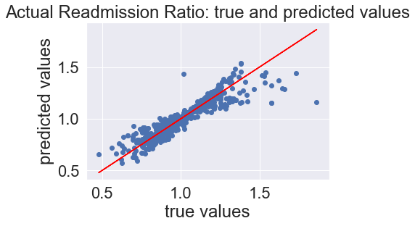
Model fitting

Slide 23
Model Selection
Model: | M1_lrm | M1_lcv | M1_rcv | M1_ecv | M1_knn | M1_dtr | M1_rfr
R_sq_train | 0.876230 | 0.876230 | 0.876230 | 0.876230 | 0.751671 | 0.857026 | 0.991622
R_sq_test | 0.820484 | 0.820487 | 0.820504 | 0.820484 | 0.603919 | 0.836714 | 0.963467
MAE | 0.034900 | 0.034898 | 0.034880 | 0.034899 | Not Available | 0.035703 | 0.012481
MSE | 0.003924 | 0.003924 | 0.003923 | 0.003924 | Not Available | 0.003789 | 0.003789
RMSE | 0.062639 | 0.062638 | 0.062635 | 0.062639 | 0.113398 | 0.061558 | 0.028885
MAPE | 3.478248 | 3.478052 | 3.476010 | 3.478156 | Not Available | 3.562417 | 1.309134
R_sq_CV | 0.862158 | 0.862158 | 0.861940 | 0.861825 | 0.484799 | 0.758590 | 0.929380
CV_scores | 0.861084 | 0.861100 | 0.860881 | 0.860796 | 0.484592 | 0.757011 | 0.929980

Slide 24
The practical uses of the model
Predictive power
For participating hospitals: more accurate predictions of the “predicted” rate of HF readmission can reduce the “excess” readmission rate, thereby saving the hospital valuable resources of staff and money
For CMS: more accurate predictions of the “expected” rate of HF readmissions can lead to improvement in the participating hospitals’ care of HF patients
Explanatory power
For both participating hospitals and CMS, a better understanding of WHY HF patients are so often readmitted at rates higher than predicted/expected can lead to improvements in both the care of these patients AND the resources used to care for them

Slide 25
Weak points/shortcomings of model
Random Tree Regressor is considered a “black box”
Concerns for over-fitting

Slide 26
Conclusions
Healthcare in the United States is among the costliest and inefficient in the industrialized world
Efforts to improve care and reduce expenses is in the best interest of all involved
Better understanding of the factors which contribute to the excess readmission rate of patients is vital in improving care and reducing expenses

